Slide 1

Vegetarian/vegan Restaurants
Expansion to EUROPE

Slide 2
Business problem
Our client is looking to expand their successful vegetarian/vegan restaurant chain
Current restaurants are dotted all over North America
Which European capital cities would be suitable for the first pilot restaurant(s)?
Limited to Western- and Northern Europe

Slide 3

CITIES TO BE INCLUDED IN STUDY
The client has given us a list of cities to explore:
Vienna, Austria
Brussels, Belgium
Prague, Czech Republic
Copenhagen, Denmark
Helsinki, Finland
Paris, France
Berlin, Germany
Rome, Italy
Dublin, Ireland
Amsterdam, The Netherlands
Oslo, Norway
Warsaw, Poland
Lisbon, Portugal
Madrid, Spain
Stockholm, Sweden
Bern, Switzerland
London, United Kingdom

Slide 4

Features to be included in study
Various types of data has been collected about the countries and cities
Proportion of vegetarians and vegans in the population
Current vegetarian/vegan restaurants in the city center
Median disposable income per household

Slide 5

Machine learning methods used in study
Missing data is included using a linear regression model, trained with the other cities
Cities are clustered using a k-means algorithm
In 5 separate clusters
Features are scaled using a robust scaler

Slide 6
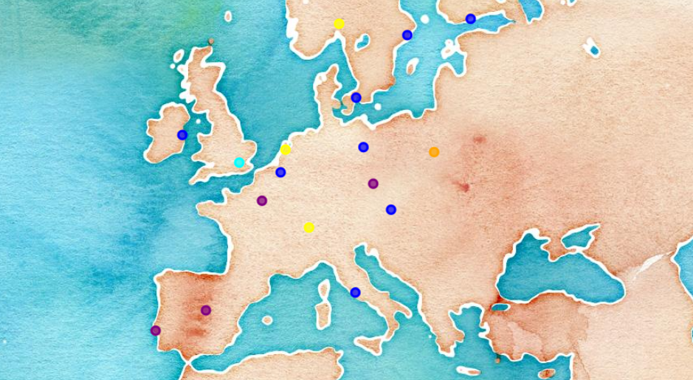
RESULTS

Slide 7
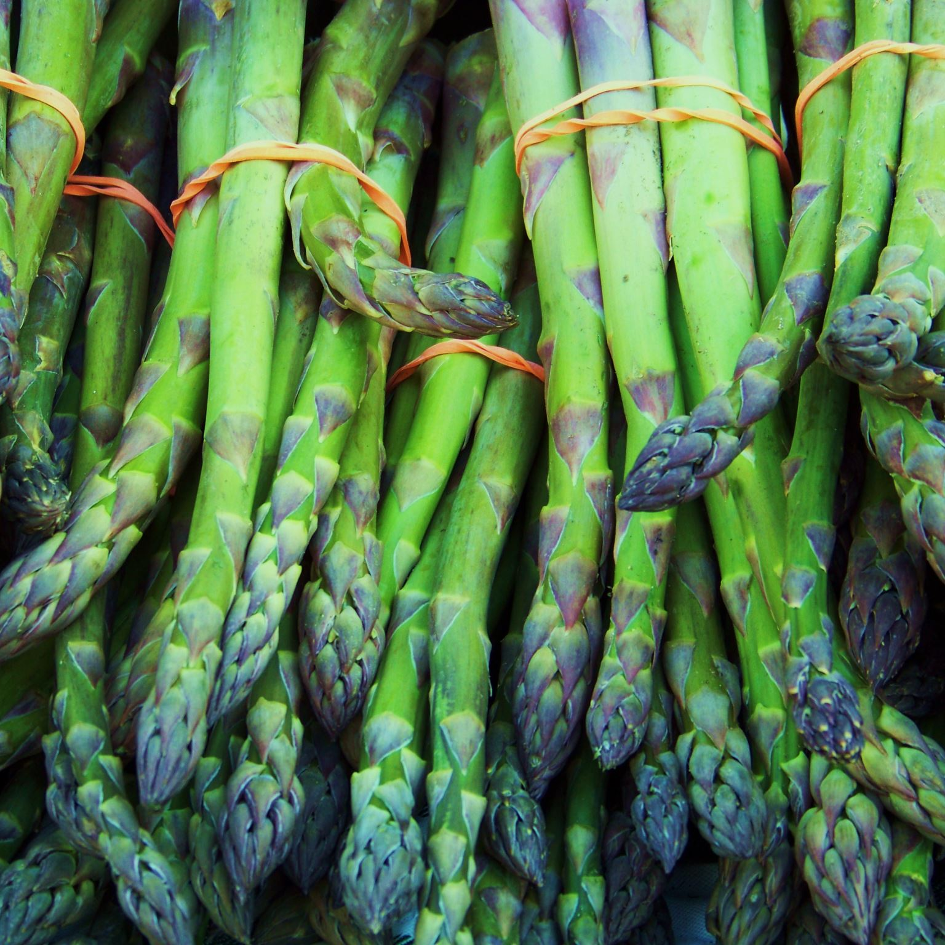
CLUSTERED CITIES (SLIDE 1 of 2)
Based on the features (% of vegetarians/vegans, # of vegetarian/vegan restaurants, and disposable income), cities have been clustered into 5 groups
Cluster 0: low number of vegetarians/vegans, medium number of current vegetarian/vegan restaurants, low disposable income.
Prague, Paris, Lisbon and Madrid
Cluster 1: high number of vegetarians/vegans, medium-to-high number of current vegetarian/vegan restaurants, medium-to-high disposable income.
Vienna, Brussels, Copenhagen, Helsinki, Berlin, Rome, Dublin and Stockholm
Cluster 2: very high number of vegetarians/vegans, very high number of current vegetarian/vegan restaurants, medium disposable income.
London

Slide 8
CLUSTERED CITIES (SLIDE 2 of 2)
Based on the features (% of vegetarians/vegans, # of vegetarian/vegan restaurants, and disposable income), cities have been clustered into 5 groups
Cluster 3: low-to-medium number of vegetarians/vegans, low number of current vegetarian/vegan restaurants, high disposable income.
Amsterdam, Oslo and Bern
Cluster 4: medium number of vegetarians/vegans, low number of current vegetarian/vegan restaurants, lowest disposable income.
Warsaw

Slide 9

CONCLUSION
We advise our client to first focus on the city in Cluster 2: London, United Kingdom
This city has a very high number of vegetarians/vegans, very high number of current vegetarian/vegan restaurants, and a medium disposable income.
If this first franchise proves successful among the European public, we advise to move on to the cities in Cluster 1: Vienna, Brussels, Copenhagen, Helsinki, Berlin, Rome, Dublin and Stockholm

Slide 10

NEXT STOP: LONDON!
Expansion to EUROPE

